Slide 1
Identifying Sepsis Subphenotypes viaTime-Aware Multi-Modal Auto-Encoder
Source: KDD '20
Speaker: Po-Jen, Wen
Advisor: Jia-Ling, Koh
Date: 2020/12/15

Slide 2
OUTLINE
Introduction
Method
Experiment
Conclusion

Slide 3
Introduction
Electronic health records (EHRs)
ICU mortality rates of subphenotypes

Slide 4
Introduction
Problem：
Most sepsis subtyping studies ignore the temporality of EHR data and suffer from missing values
May have missing value
An segment of a patient’ EHR data

Slide 5
Introduction-Framework
Goal：
To impute missing values with new framework Time-Aware Multi-modal auto-Encoder
Adopt Dynamic Time Wrapping (DTW) to calculate the temporal similarity between patients with the imputed data
Cluster the patients with weighted k-means

Slide 6
Method - TAME
$$v_{t−1,i}$$
Max pooling layer
Fully connected layer

Slide 7
TAME - Basic notation
$D^{e} including age a and gender g$
$D=\left[d_{1},d_{2}, …, d_{\left|D\right|}\right] ε N^{|D|}$
$X =\left[x_{1},x_{2}, …, x_{\left|X\right|}\right] ε R^{|X|×K_{x}}$
$M=[m_{1},m_{2},…,m_{\left|M\right|}]ε N^{|M|}$
$M_{t}⊆\left\{1, 2, …, \left|M\right|\right\}$
Before embedding

Slide 8
TAME - Demographics, Diagnosis and Medication Embedding
$E^{D^{e}}εR^{2×K} (ages are code\text{d} \text{to} \text{several} \text{age} \text{groups}\text{)}$
$E^{D}=\left[e_{1}^{d},e_{2}^{d},…,e_{\left|D\right|}^{d}\right]εR^{\left|D\right|×K}$
$E^{M}=\left[e_{1}^{m},e_{2}^{m},…,e_{\left|M\right|}^{m}\right]εR^{\left|M\right|×K}$
$E^{M_{t}}=\left[e_{t_{1}}^{m},e_{t_{2}}^{m},…,e_{t_{|M_{t}|}}^{m}\right]εR^{\left|M_{t}\right|×K}$

Slide 9
TAME - Basic notation
masking matrix $C,A$ , to address the missing value.
$C=\left[c_{1},c_{2},…,c_{\left|x\right|}\right],A=\left[a_{1},a_{2},…,a_{\left|x\right|}\right]∈{\{0,1\}}^{|X|×K_{x}}$
ground truth | 1 | 1 | 1 | 0 | 1 | 1 | 1 | 1 | 0
$$x_{t}^{i}$$ | 12 | 10 | miss | none | 12 | 8 | miss | 8 | none
$$c_{t}^{i}$$ | 1 | 1 | 0 | 0 | 1 | 1 | 0 | 1 | 0
$$a_{t}^{i}$$ | 0 | 0 | 1 | 0 | 0 | 0 | 1 | 0 | 0

Slide 10
TAME - Variable Value Embedding
Before embedding， they normalize the values of variable i：$x^{i}=\frac{x^{i}−mean\left(x^{i}\right)}{std\left(x^{i}\right)}$
$e^{i}εR^{K}$
sort the values and discretize the values into V sub-ranges $v$(1 ≤ v ≤ V )
$e^{′v}εR^{2K} , where 0≤j<k$
$e_{j}^{′v} =sin⁡(\frac{v∗j}{V∗k})$
$e_{j+k}^{′v}=\cos\left(\frac{v∗j}{V∗k}\right)$
Fully connected layer
$$e^{iv}=\left[e^{i};e^{′v}\right]W_{iv}+b_{iv} ∈R^{k}$$
$W_{iv}$ $∈R^{3k∗k}$, $b_{iv} ∈R^{k}$

Slide 11
TAME - Variable Value Embedding
stacking the observed values’ embedding vectors in the same collection $t$ as $x^{t}$
$E_{t}^{X}∈R^{n_{t}×k} , where n_{t}=\sum_{i}{\left(c_{t}^{i}\right)}$

Slide 12
TAME - Multi-modal Embedding Combination
$E^{D^{e}},E^{D},E_{t}^{M},E_{t}^{X}∈R^{∗×k}$
Fully connected layer project into same semantic space, obtain $E_{t}∈R^{∗×k}$
Max-pooling layer , map $E_{t}$ to an vector $e_{t}∈R^{k}$

Slide 13
TAME - Basic notation
time gap vector and matrices$∆εR^{|X|}{,∆}^{(l)}εR^{|X|×K_{x}}{,∆}^{(n)}εR^{|X|×K_{x}}$.
t | 1 | 2 | 3 | 4 | 5 | 6 | 7 | 8 | 9
$$c_{t}^{i}$$ | 1 | 1 | 0 | 0 | 1 | 1 | 0 | 1 | 0
$$∆_{t}^{\left(l\right),i}$$ | 0 | 1 | 1 | 2 | 3 | 1 | 1 | 2 | 1
$$∆_{t}^{\left(n\right),i}$$ | 1 | 3 | 2 | 1 | 1 | 2 | 1

Slide 14
TAME - Time Embedding
time gap $δ , e^{δ}∈R^{2k}, where 0≤j<k$
$e_{j}^{δ} =sin⁡(\frac{δ∗j}{T_{m}∗k})$
$e_{j+k}^{δ}=\cos\left(\frac{δ∗j}{T_{m}∗k}\right)$
$T_{m}$is the maximum of time gap($0≤δ<T_{m})$
$e^{∆,(l)}∈R^{|X|×K_{x}×2k}$
$e^{∆,(n)}∈R^{|X|×K_{x}×2k}$
Notes:
$$∆εR^{|X|}{,∆}^{(l)}εR^{|X|×K_{x}}{,∆}^{(n)}εR^{|X|×K_{x}}$$

Slide 15
TAME - Bi-LSTM Architecture
${\hat{e}}_{t}=e_{t}W_{e}+e_{t}^{∆}W_{∆}+b_{e}$
$W_{e}∈R^{k×k},W_{∆}∈R^{2k×k},b_{e}∈R^{k×k}$
$\vec{h_{1}},\vec{h_{2}},…,\vec{h_{\left|X\right|}}=\vec{LSTM}\left({\hat{e}}_{1}{,\hat{e}}_{2},…,{\hat{e}}_{\left|X\right|}\right)$
$\overset{⃖}{h_{1}},\overset{⃖}{h_{2}},…, \overset{⃖}{h_{\left|X\right|}}=\overset{⃖}{LSTM} ({\hat{e}}_{1}{,\hat{e}}_{2},…,{\hat{e}}_{\left|X\right|})$
$h_{t}=\left[\vec{h_{t}};\overset{⃖}{h_{t}}\right] for t=1,2,…,\left|X\right|∈R^{2k}$

Slide 16
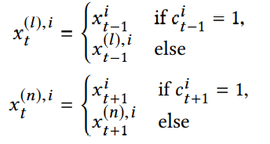
TAME - Basic notation
neighbouring value matrices
$X^{(l)}=\left[x_{1}^{\left(l\right)},x_{2}^{\left(l\right)},…,x_{|X|}^{\left(l\right)}\right]εR^{|X|×K_{x}} , X^{(n)}=\left[x_{1}^{\left(n\right)},x_{2}^{\left(n\right)},…,x_{|X|}^{\left(n\right)}\right]εR^{|X|×K_{x}}$
$$x_{t}^{i}$$ | 12 | none | miss | none | 9 | 8 | miss | 13 | 7
$$c_{t}^{i}$$ | 1 | 0 | 0 | 0 | 1 | 1 | 0 | 1 | 1
$$x_{t}^{\left(l\right),i}$$ | 0 | 12 | 12 | 12 | 12 | 9 | 8 | 8 | 13
$$x_{t}^{\left(n\right),i}$$ | 9 | 9 | 9 | 9 | 8 | 13 | 13 | 7 | $$x_{10}^{i}$$

Slide 17
TAME - Time-Aware Attention
map the latest observed variables with their corresponding time gaps into a new space.
$v_{t}^{\left(l\right)}=e_{t}^{∆,(l)}W_{l,∆}+E_{t}^{X,(l)}W_{l,e}+b_{l}$
$v_{t}^{\left(n\right)}=e_{t}^{∆,(n)}W_{n,∆}+E_{t}^{X,(n)}W_{n,e}+b_{n}$
$E_{t}^{X,\left(l\right)}∈R^{K_{x}×k} , 1≤t≤\left|X\right|、E_{t}^{X,\left(n\right)}∈R^{K_{x}×k} , 1≤t≤|X|$
$W_{l,∆},W_{n,∆}∈R^{k×2k}$, $W_{l,e},W_{n,e}∈R^{k×k}$, $b_{l},b_{n}∈R^{k}$
[$v_{t}^{\left(l\right)};v_{t}^{\left(n\right)}$] $∈R^{K_{x}×2k}$

Slide 18
TAME - Time-Aware Attention
$β_{t,i}=v_{t,i}W_{β}+h_{t}W_{h}+b_{β}$
$α_{t,i}=\frac{exp⁡(β_{t,i})}{\sum_{i}{exp⁡(β_{t,i})}}$
$v_{t}^{a}=\sum_{i}{{v_{t,i}∗α}_{t,i}}$
$v_{t}^{a}∈R^{k}$, $W_{β}∈R^{k}\text{, }W_{h}∈R^{2k}\text{, }b_{β}∈R$
key
query
value

Slide 19
TAME - Output and Objective Function
${\tilde{x}}_{t}=v_{t}^{a}W_{x,v}+h_{t}W_{x,h}+b_{x}$
$W_{x,v}∈R^{k×K_{x}},W_{x,h}∈R^{2k×K_{x}},b_{x}∈R^{K_{x}}$
Loss function：mean square error
$l_{t}\left({{\tilde{x}}_{t},\hat{x}}_{t}\right)=\frac{\sum_{i}{c_{t}^{i}{\left({{\tilde{x}}_{t}−\hat{x}}_{t}\right)}^{2}}}{\sum_{i}{c_{t}^{i}}}+\frac{\sum_{i}{a_{t}^{i}{({{\tilde{x}}_{t}−\hat{x}}_{t})}^{2}}}{\sum_{i}{a_{t}^{i}}}$

Slide 20
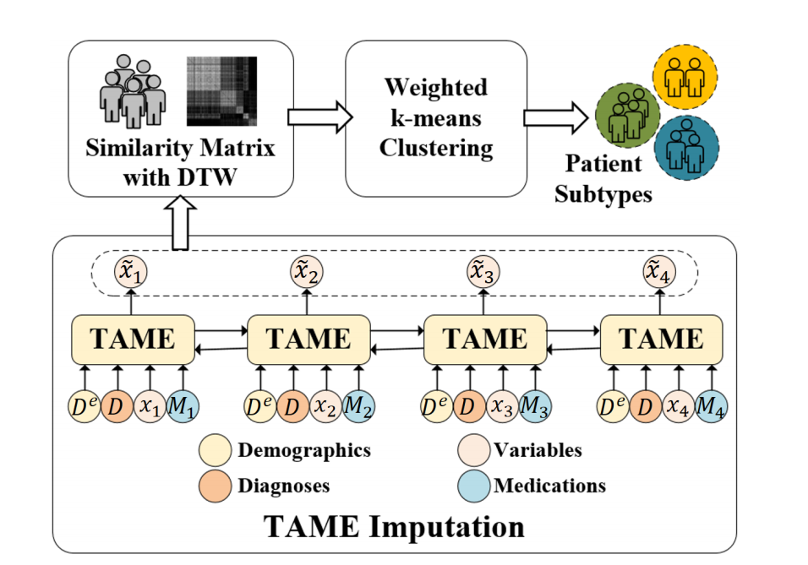
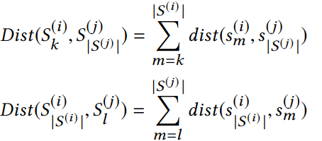
Method - Dynamic Time Wrapping
$S^{\left(i\right)}=\left[s_{1}^{\left(i\right)},s_{2}^{\left(i\right)},…,s_{S^{\left(i\right)}}^{\left(i\right)}\right]εR^{\left|S^{\left(i\right)}\right|×K_{x}}$
Euclidean distance
boundary condition
Notes:
dynamic time wrapping

Slide 21
Method - DTW
Euclidean distance matrix
cumulative distances matrix
X/Y | 1 | 1 | 8 | 7 | 6 | 6 | 3
1 | 0 | 0 | 7 | 6 | 5 | 5 | 2
7 | 6 | 6 | 1 | 0 | 1 | 1 | 4
7 | 6 | 6 | 1 | 0 | 1 | 1 | 4
6 | 5 | 5 | 2 | 1 | 0 | 0 | 3
5 | 4 | 4 | 3 | 2 | 1 | 1 | 2
3 | 2 | 2 | 5 | 4 | 3 | 3 | 0
X/Y | 1 | 1 | 8 | 7 | 6 | 6 | 3
1 | 2 | 2 | 8 | 7 | 8 | 8 | 15
7 | 14 | 8 | 2 | 1 | 3 | 3 | 13
7 | 14 | 8 | 2 | 1 | 2 | 2 | 9
6 | 14 | 9 | 4 | 2 | 1 | 1 | 5
5 | 15 | 11 | 7 | 4 | 2 | 1 | 2
3 | 19 | 17 | 15 | 10 | 6 | 3 | 0

Slide 22
Method - Weighted K-means Clustering
${Dist}_{g}\left(S^{\left(i\right)},G_{k}\right)=\frac{\sum_{j∈G_{k}}{{Dist}_{p}\left(S^{\left(i\right)},S^{\left(j\right)}\right)∗w_{j}}}{\sum_{j∈G_{k}}{w_{j}}}$
$w_{j}={\left(1+\exp\left(\sum_{l∈G_{k}}{\frac{{Dist}_{p}\left(S^{j},S^{\left(l\right)}\right)}{{|G}_{k}|}}\right)\right)}^{−1} j∈G_{k}$

Slide 23
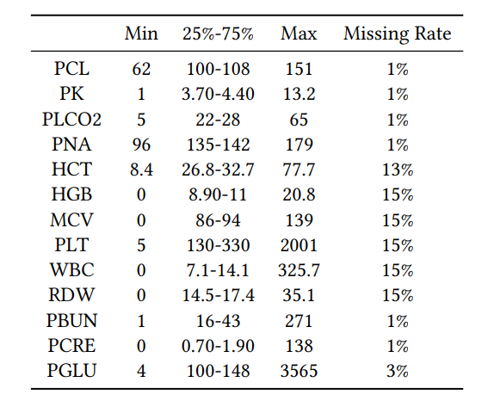
Experiment
measure the models’ performance with nRMSE
${nRMSE}^{i}=\sqrt{\frac{\sum_{j}{\sum_{t}{a_{t}^{\left(j\right),i}{\left({\tilde{x}}_{t}^{\left(j\right),i}−{\hat{x}}_{t}^{\left(j\right),i}\right)}^{2}}}}{\sum_{j}{\sum_{t}{a_{t}^{\left(j\right),i}}}}}$

Slide 24
Experiment

Slide 25
Experiment
measure the models’ performance with nRMSE
${nRMSE}^{i}=\sqrt{\frac{\sum_{j}{\sum_{t}{a_{t}^{\left(j\right),i}{\left({\tilde{x}}_{t}^{\left(j\right),i}−{\hat{x}}_{t}^{\left(j\right),i}\right)}^{2}}}}{\sum_{j}{\sum_{t}{a_{t}^{\left(j\right),i}}}}}$
Notes:
$$a_{t}^{\left(j\right),i}{ masking indicator \tilde{x}}_{t}^{\left(j\right),i} impute value {\hat{x}}_{t}^{\left(j\right),i} groud truth$$

Slide 26
Experiment

Slide 27
Experiment
Calinski-Harabasz index：
$s=\frac{tr\left(B_{k}\right)}{tr\left(W_{k}\right)}×\frac{n_{E−k}}{k−1}$
$W_{k}=\sum_{q=1}^{k}{\sum_{xεC_{q}}{\left(x−C_{q}\right){\left(x−C_{q}\right)}^{T}}}$
$B_{k}=\sum_{q=1}^{k}{n_{q}\left(C_{q}−C_{E}\right){\left(C_{q}−C_{E}\right)}^{T}}$
Davies-Bouldin index：
$DB=\frac{1}{n}\sum_{i=1}^{n}{\left(\frac{σ_{i}+σ_{j}}{d\left(c_{i},c_{j}\right)}\right)}$

Slide 28
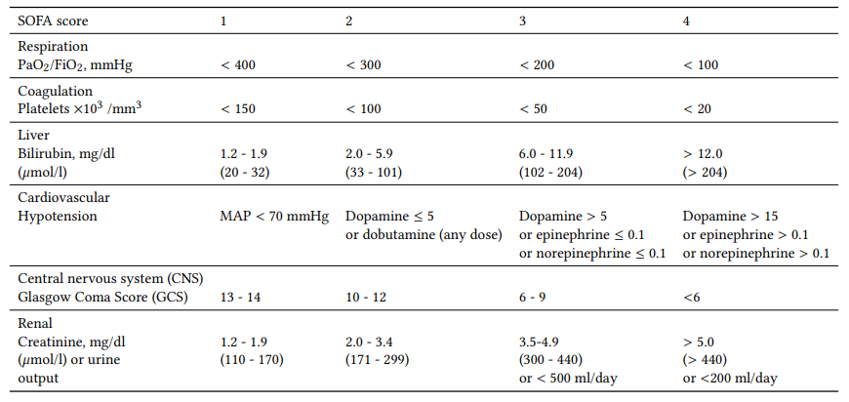
Experiment
Four subphenotypes：
Minimal Organ Dysfunction
Renal Dysfunction
CNS & Respiration Dysfunction
Maximum Organ Dysfunction

Slide 29
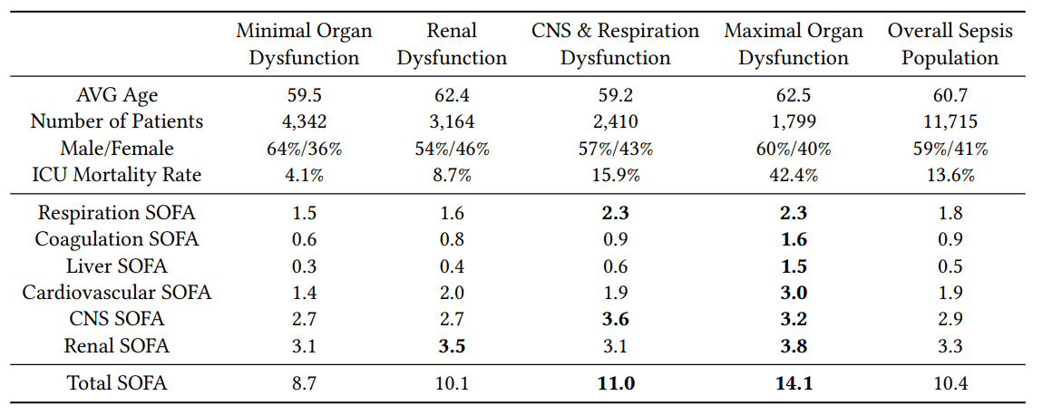
Experiment

Slide 30
Conclusion
Propose a novel clinical data imputation model TAME to generate results for missing values, model can handle varying numbers of observed variables in different collections without any prefilling operation and capture the cross-variable, cross-modal, longitudinal information.
Propose a new patient subtyping framework with DTW and weighed k-means, DTW to compute the temporal similarity matrix,and weighted k-means to group sepsis patients with the similarity matrix and identify four meaningful subphenotypes

